Slide 1
Empowering Patients with Home Dialysis
Alliance for Home Dialysis
December 6, 2023

Slide 2
Speakers
Emily Mace | Legislative Director & Counsel, Rep. Larry Bucshon (R-IN)
Abe Friedman | Senior Policy Advisor, Rep. Suzan DelBene (D-WA)
Page Salenger, M.D. | former Director of Home Therapies, DCI, practicing PCP/Nephrologist
Paul Conway | Chair of Policy & Global Affairs, American Association of Kidney Patients (AAKP), 46-year kidney patient and 26-year transplant recipient
Moderator: Margaret French | Managing Director, Legislative Affairs, Alliance for Home Dialysis

Slide 3
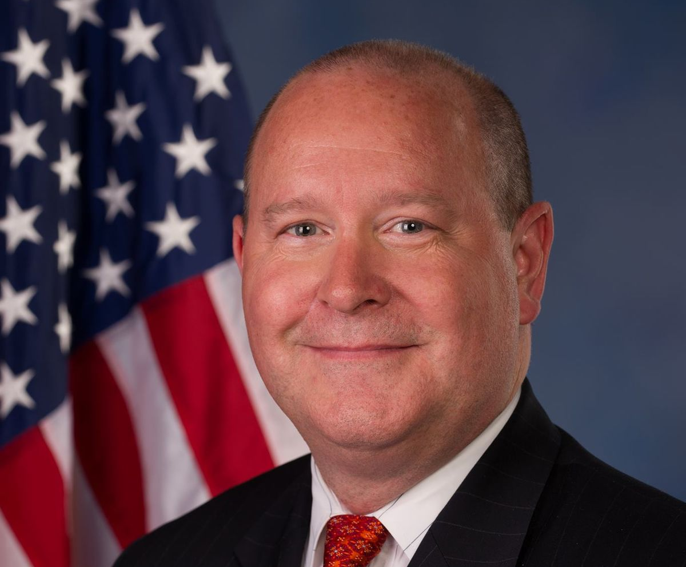
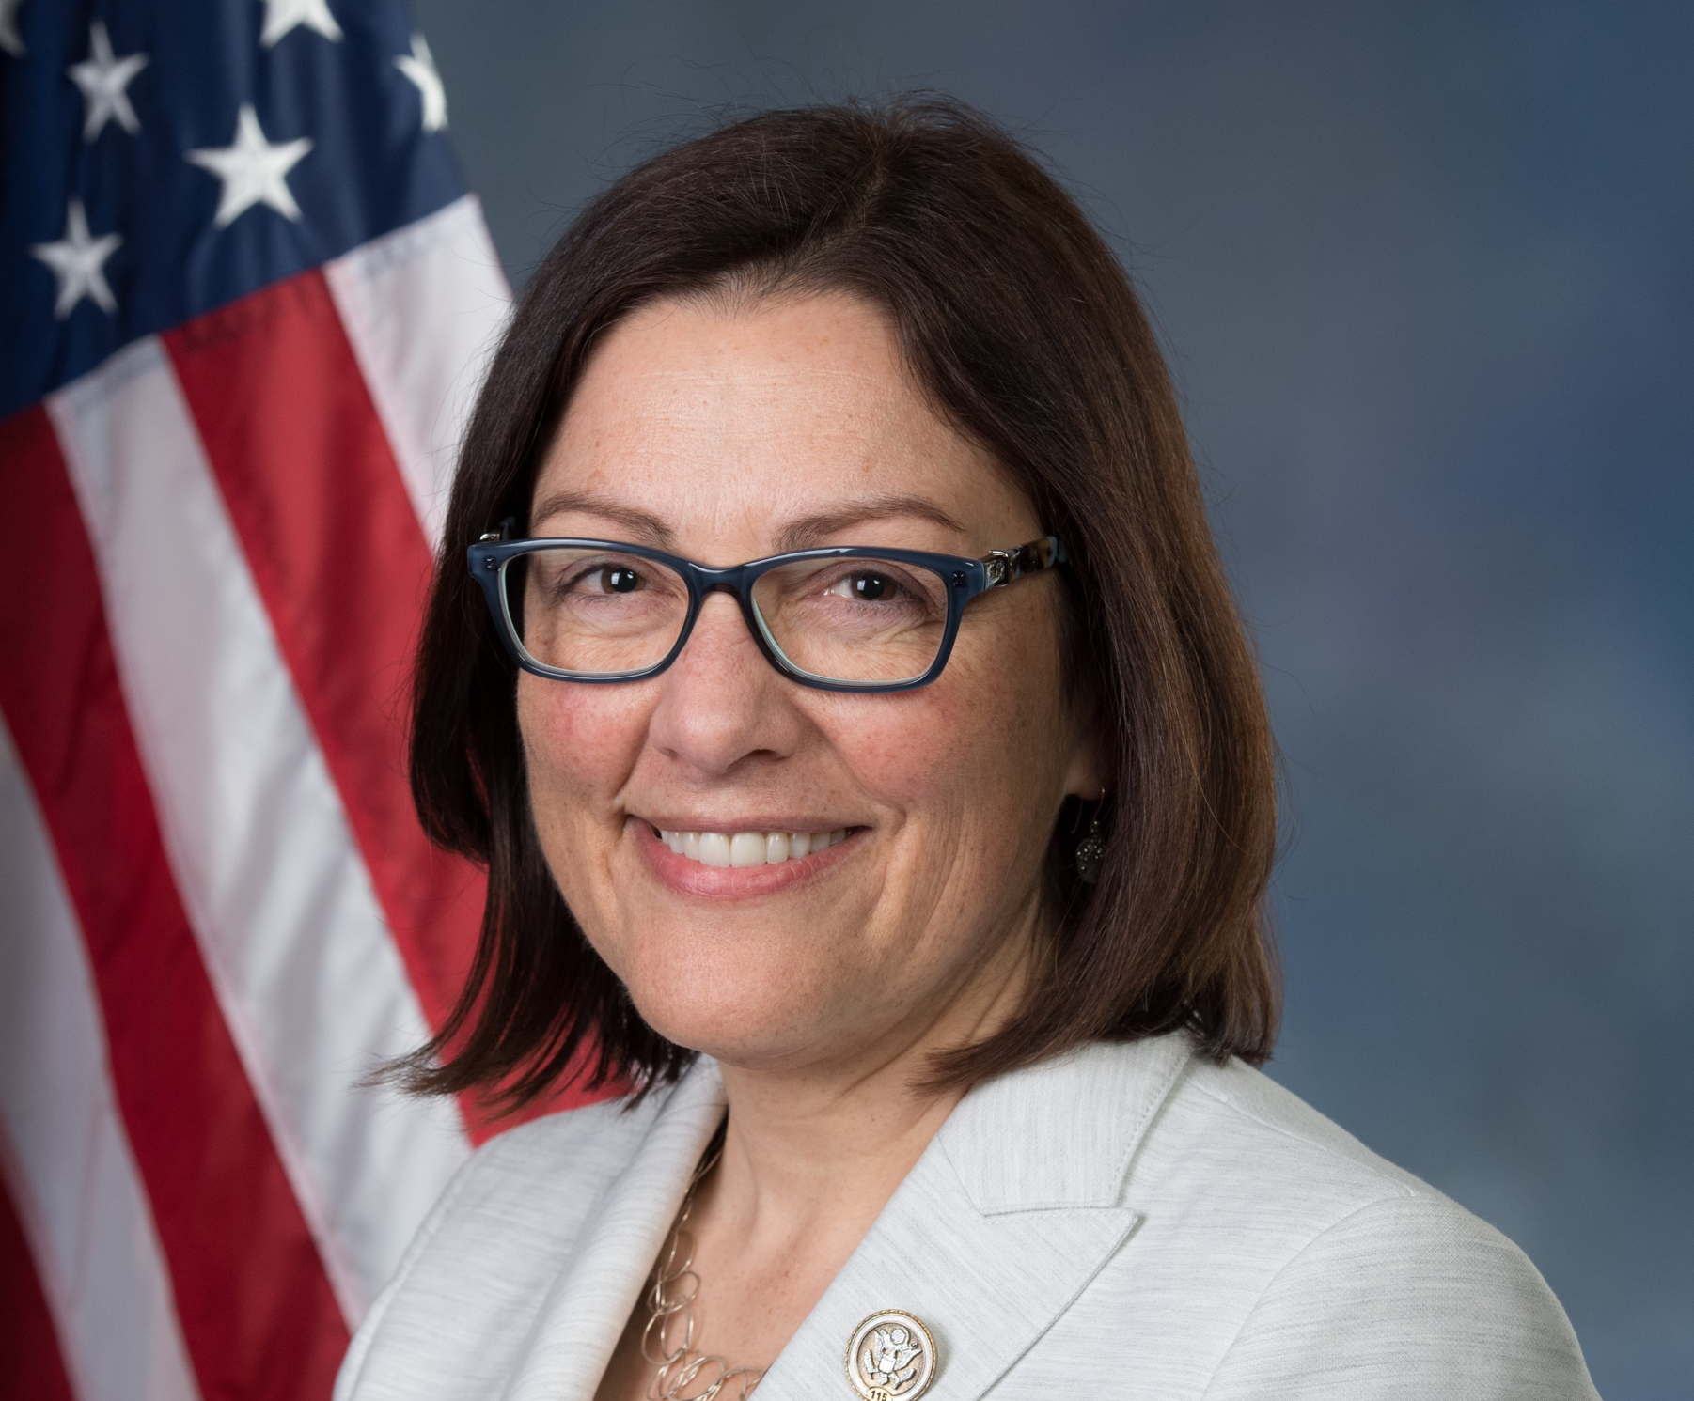
Congressional Kidney Caucus
Co-Chaired by Reps. Larry Bucshon (R-IN) and Suzan DelBene (D-WA)
The Congressional Kidney Caucus was created in 2002 to educate lawmakers and the American people about chronic kidney disease (CKD) and the role that the federal government has in expanding access to care for providing the millions of Americans suffering from CKD.

Slide 4
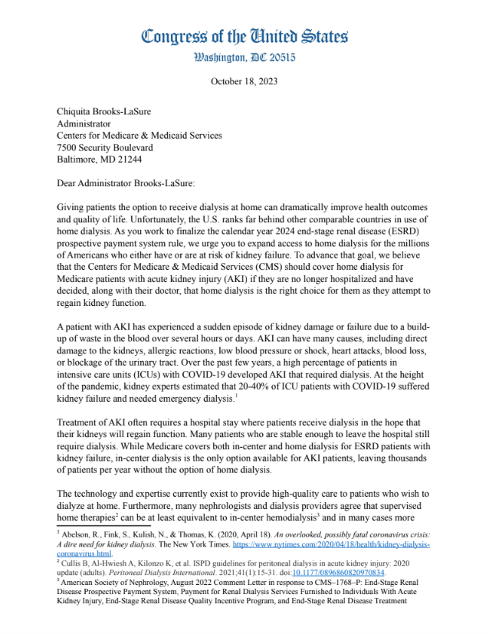
Congressional Letter on AKI
Currently, Medicare covers in-center and home dialysis for patients with kidney failure, but Medicare does not cover home dialysis for patients with acute kidney injury (AKI).
On Oct. 18, four members of the Congress wrote to CMS to urge coverage for home dialysis for AKI patients.
The technology and expertise currently exist to provide high-quality care to patients who wish to dialyze at home
“We strongly urge Medicare to expand access to home dialysis, including for AKI patients. Increasing access and improving outcomes for AKI patients is especially important because these patients have the potential to recover kidney function and avoid permanent kidney failure requiring years of dialysis or transplant.”

Slide 5
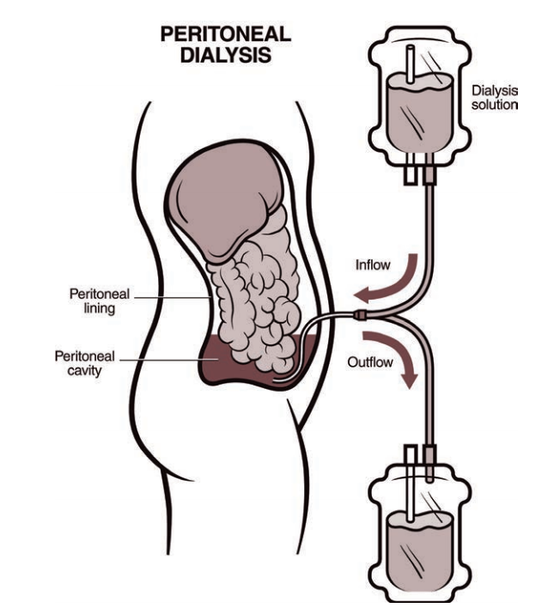
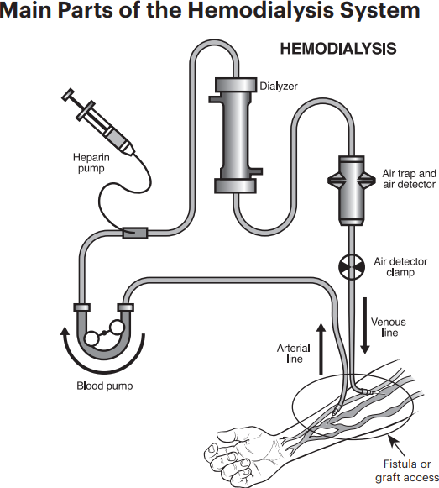
Home Dialysis
Different modalities
Peritoneal dialysis (PD)
Home hemodialysis (HHD)
Benefits
Quality of life
Patient independence, ability to travel, greater employment and family caregiving opportunities
Medical outcomes
Potential for Medicare savings
Images courtesy of National Kidney Foundation

Slide 6
Barriers to Home Dialysis
Lack of patient education, training.
Patient perceptions.
Provider barriers and educational gaps.
Social determinants.
Housing insecurity.
Housing infrastructure (water, electrical, size of home).
Lack of health literacy.
Lack of caregiver or care partner support.
Patient and family burnout

Slide 7
Provider’s Role
Facilitate patient choice.
Provide education for patients and families.
Leverage care team for training, navigating the system.

Slide 8
American Association of Kidney Patients
Dedicated to improving the lives and long-term outcomes of kidney patients through education, advocacy, patient engagement and the fostering of patient communities.
AAKP’s aim:
Educate: patients & caregivers.
Advocate: for policies that improve treatment and extend life for kidney disease patients – always defending patient choice.

Slide 9
Medicare and ESRD
Medicare covers ESRD services regardless of patient age.
ESRD accounts for 1% of Medicare patients but 7% of costs.
Payment:
Medicare bundle—costs of dialysis treatments, medications, labs and supplies are paid to the clinic or provider by Medicare Part B in one payment rather than a separate payment for each item.
ESRD Treatment Choices (ETC) model—mandatory participation for 1/3 of providers, designed to encourage home dialysis and kidney transplants for people with ESRD, first CMMI model to incorporate health equity into provider performance scoring and payment incentives.
Approximately 130,000 Medicare beneficiaries are attributed to the ETC Model(3,600 dialysis facilities and 3,400 clinicians).

Slide 10
Congress’s Role
Partner with patients, providers, stakeholders.
Facilitate ESRD policy that:
Empowers patients.
Increases both patent safety and accessibility.
Tears down barriers between in-center and home dialysis.

Slide 11
Questions

